Slide 1
Access Control
Corporate Computer Security, 4th Edition
Randall J. Boyle & Raymond R. Panko
Chapter 5

Slide 2
Learning Objectives
Define basic access control terminology.
Describe physical building and computer security.
Explain reusable passwords.
Explain how access cards and tokens work.
Describe biometric authentication, including verification and identification.
Explain authorizations.
Explain auditing.
Describe how central authentication servers work.
Describe how directory servers work.
Define full identity management.

Slide 3
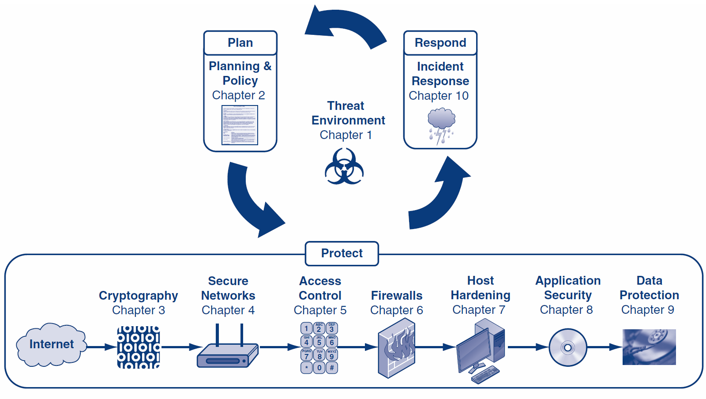

Slide 4
Orientation
If attackers cannot get access to your resources, they cannot attack them
This chapter presents a number of important access control tools, such as reusable passwords and biometrics
We covered crypto before access controls because many access controls use cryptography
However, not all access controls use crypto, and those that do usually use it for only part of their process

Slide 5
What’s Next?
5.1 Introduction
5.2 Physical Access and Security
5.3 Passwords
5.4 Access Cards and Tokens
5.5 Biometric Authentication
5.6 Cryptographic Authentication
5.7 Authorization
5.8 Auditing
5.9 Central Authentication Servers
5.10 Directory Servers and Identity Management

Slide 6
5.1: Access Control
Access Controls
Firms must limit access to physical and electronic resources
Access control is the policy-driven control of access to systems, data, and dialogues
Cryptography
Many access control tools use cryptography to some extent
However, cryptography is only part of what they do and how they work

Slide 7
5.1: Access Control
The AAA Protections
Authentication—supplicant sends credentials to verifier to authenticate the supplicant
Authorization—what permissions the authenticated user will have
What resources he or she can get to at all
What he or she can do with these resources
Auditing—recording what people do in log files
Detecting attacks
Identifying breakdowns in implementation

Slide 8
5.1: Access Control
Beyond Passwords
Passwords used to be sufficiently strong
This is no longer true thanks to increasing computer speeds available to hackers
Companies must move to better authentication options

Slide 9
5.1: Access Control
Credentials Are Based On
What you know (e.g., a password)
What you have (e.g., an access card)
What you are (e.g., your fingerprint) or
What you do (e.g., speaking a passphrase)

Slide 10
5.1: Access Control
Two-Factor Authentication
Use two forms of authentication for defense in depth
Example: access card and personal identification number (PIN)
Multifactor authentication: two or more types of authentication
Can be defeated by a Trojan horse on the user’s PC
Can also be defeated by a man-in-the-middle attack by a fake website

Slide 11
5.1: Access Control
Individual and Role-Based Access Control
Individual access control: bases access rules on individual accounts
Role-based access control (RBAC)
Bases access rules on organizational roles (e.g., buyer, member of a team, etc.)
Assigns individual accounts to roles to give them access to each role’s resources
Cheaper and less error-prone than basing access rules on individual accounts

Slide 12
5.1: Access Control
Human and Organizational Controls
People and organizational forces may circumvent access protections

Slide 13
5.1: Military and National Security Organization Access Controls
Mandatory and Discretionary Access Control
Mandatory access control (MAC)
No departmental or personal ability to alter access control rules set by higher authorities
Discretionary access control (DAC)
Departmental or personal ability to alter access control rules set by higher authorities
MAC gives stronger security but is very difficult to implement

Slide 14
5.1: Military and National Security Organization Access Controls
Multilevel Security
Resources are rated by security level
Public
Sensitive but unclassified
Secret
Top secret
People are given the same clearance level

Slide 15
5.1: Military and National Security Organization Access Controls
Multilevel Security
Some rules are simple
People with a secret clearance cannot read top secret documents
Some rules are complex
What if a paragraph from a top secret document is placed in a secret document?
Access control models have been created to address multilevel security
Will not discuss because not pertinent to corporations

Slide 16
What’s Next?
5.1 Introduction
5.2 Physical Access and Security
5.3 Passwords
5.4 Access Cards and Tokens
5.5 Biometric Authentication
5.6 Cryptographic Authentication
5.7 Authorization
5.8 Auditing
5.9 Central Authentication Servers
5.10 Directory Servers and Identity Management

Slide 17
5.2: ISO/IEC 27002:2005 Physical and Environmental Security
ISO/IEC 27002’s Security Clause 9, Physical and Environmental Security
Risk Analysis Must Be Done First
ISO/IEC 9.1: Secure Areas
Securing the building’s physical perimeter (e.g., single point of entry, emergency exits, etc.)
Implementing physical entry controls
Access should be justified, authorized, logged, and monitored

Slide 18
5.2: ISO/IEC 27002:2005 Physical and Environmental Security
ISO/IEC 9.1: Secure Areas
Securing public access, delivery, and loading areas
Securing offices, rooms, and facilities
Protecting against external and environmental threats
Creating rules for working in secure areas
Limit unsupervised work, forbid data recording devices, etc.

Slide 19
5.2: ISO/IEC 27002:2005 Physical and Environmental Security
9.2 Equipment Security
Equipment siting and protection
Siting means locating or placing (same root as site)
Supporting utilities (e.g., electricity, water, HVAC)
Uninterruptible power supplies, electrical generators
Frequent testing

Slide 20
5.2: ISO/IEC 27002:2005 Physical and Environmental Security
9.2 Equipment Security
Cabling security (e.g., conduits, underground wiring, etc.)
Security during offsite equipment maintenance
Permission for taking offsite
Removal of sensitive information

Slide 21
5.2: ISO/IEC 27002:2005 Physical and Environmental Security
9.2 Equipment Security
Security of equipment off-premises
Constant attendance except when locked securely
Insurance
Secure disposal or reuse of equipment
Removal of all sensitive information
Rules for the removal of property

Slide 22
5.2: Other Physical Security Issues
Terrorism
Building set back from street
Armed guards
Bullet-proof glass
Piggybacking
Following an authorized user through a door
Also called tailgating
Psychologically difficult to prevent
Piggybacking is worth the effort to prevent

Slide 23
5.2: Other Physical Security Issues
Monitoring Equipment
CCTV
Tapes wear out
High-resolution cameras are expensive and consume a great deal of disk space
Low-resolution cameras may be insufficient for recognition needs
To reduce storage, use motion sensing

Slide 24
5.2: Other Physical Security Issues
Dumpster^{[TM]} Diving
Protect building trash bins that may contain sensitive information
Maintain trash inside the corporate premises and monitor until removed
Desktop PC Security
Locks that connect the computer to an immovable object
Login screens with strong passwords

Slide 25
What’s Next?
5.1 Introduction
5.2 Physical Access and Security
5.3 Passwords
5.4 Access Cards and Tokens
5.5 Biometric Authentication
5.6 Cryptographic Authentication
5.7 Authorization
5.8 Auditing
5.9 Central Authentication Servers
5.10 Directory Servers and Identity Management

Slide 26
5.3: Server Password Cracking
Reusable Passwords
A password that is used multiple times
Almost all passwords are reusable passwords
A one-time password is used only once

Slide 27
5.3: Server Password Cracking
Difficulty of Cracking Passwords by Guessing Remotely
Account is usually locked after a few login failures
Password-Cracking Programs
Password-cracking programs exist
Run on a computer to crack its passwords or
Run on a downloaded password file

Slide 28
5.3: Password Policies
Password Policies
Regularly test the strength of internal passwords
Not using the same password at multiple sites
Use password management programs
Password duration policies
Shared password policies (makes auditing impossible)
Disabling passwords that are no longer valid

Slide 29
5.3: Password Policies
Other Password Policies
Lost passwords (password resets)
Opportunities for social engineering attacks
Automated password resets use secret questions (i.e., Where were you born?)
Many can be guessed with a little research, rendering passwords useless
Some questions may violate security policies

Slide 30
5.3: Password Policies
Password Strength Policies
Password policies must be long and complex
At least 8 characters long
Change of case, not at beginning
Digit (0 through 9), not at end
Other keyboard character, not at end
Example: tri6#Vial
Completely random passwords are best but usually are written down

Slide 31
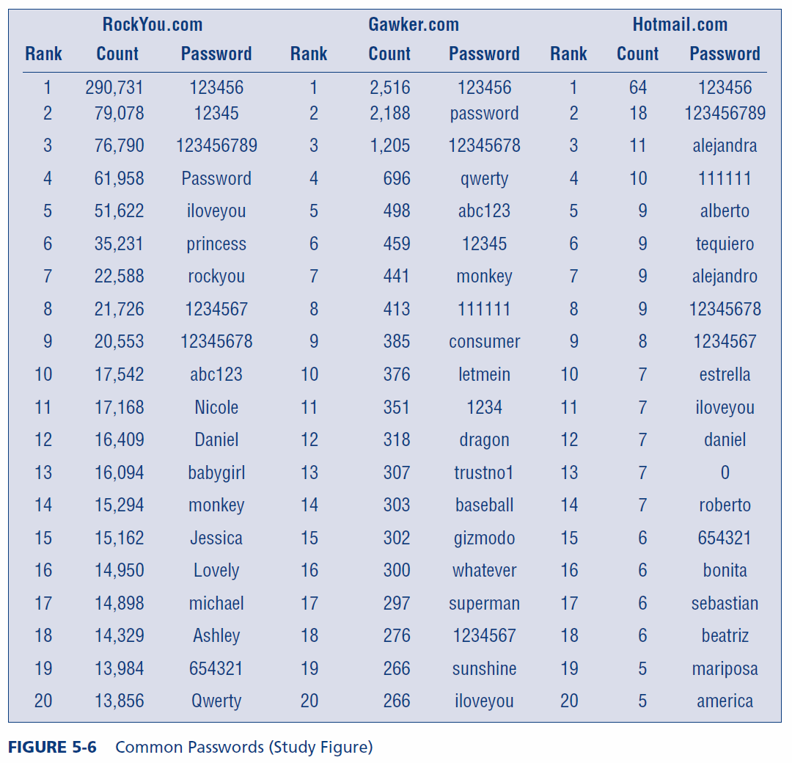

Slide 32
5.3: Password Policies
The End of Passwords?
Many firms want to eliminate passwords because of their weaknesses
Quite a few firms have already largely phased them out

Slide 33
What’s Next?
5.1 Introduction
5.2 Physical Access and Security
5.3 Passwords
5.4 Access Cards and Tokens
5.5 Biometric Authentication
5.6 Cryptographic Authentication
5.7 Authorization
5.8 Auditing
5.9 Central Authentication Servers
5.10 Directory Servers and Identity Management

Slide 34
5.4: Access Cards and Tokens
Access Cards
Magnetic stripe cards
Smart cards
Have a microprocessor and RAM
Can implement public key encryption for challenge/response authentication
In selection decision, must consider cost and availability of card readers

Slide 35
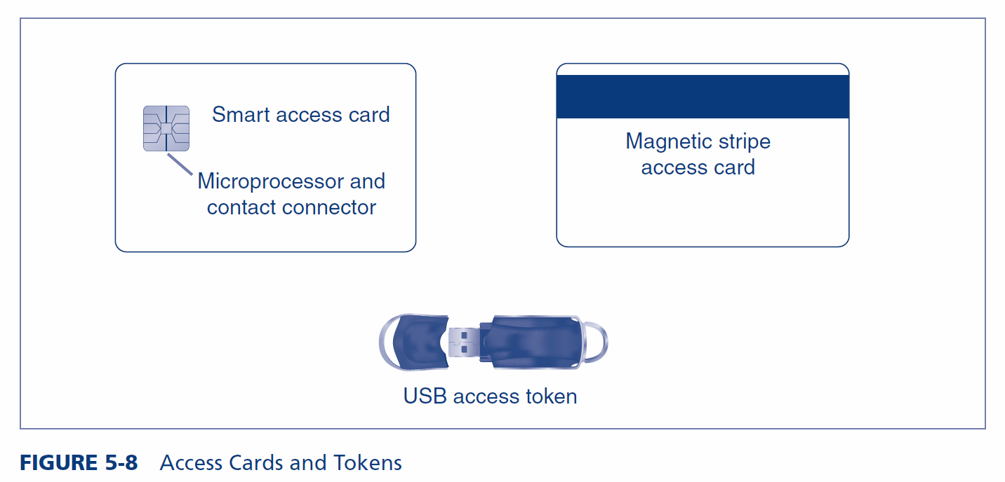
5.4: Access Cards and Tokens

Slide 36
5.4: Access Cards and Tokens
Tokens
Constantly changing password devices for one-time passwords
USB plug-in tokens

Slide 37
5.4: Access Cards and Tokens
Proximity Access Tokens
Use Radio Frequency ID (RFID) technology
Supplicant only has to be near a door or computer to be recognized
Addressing Loss and Theft
Both are frequent
Card cancellation
Requires a wired network for cancellation speed
Must cancel quickly if risks are considerable

Slide 38
5.4: Access Cards and Tokens
Two-Factor Authentication Needed because of Ease of Loss and Theft
PINs (Personal Identification Numbers) for the second factor
Short: 4 to 6 digits
Can be short because attempts are manual
Should not choose obvious combinations (e.g., 1111, 1234) or important dates
Other forms of two-factor authentication
Store fingerprint template on device; check supplicant with a fingerprint reader

Slide 39
What’s Next?
5.1 Introduction
5.2 Physical Access and Security
5.3 Passwords
5.4 Access Cards and Tokens
5.5 Biometric Authentication
5.6 Cryptographic Authentication
5.7 Authorization
5.8 Auditing
5.9 Central Authentication Servers
5.10 Directory Servers and Identity Management

Slide 40
5.5: Biometric Authentication
Biometric Authentication
Authentication based on biological (bio) measurements (metrics)
Biometric authentication is based on something you are (e.g., your fingerprint, iris pattern, face, hand geometry, and so forth)
Or something you do (e.g., write, type, and so forth)
The major promise of biometrics is to make reusable passwords obsolete

Slide 41
5.5: Biometric Authentication
Biometric Systems (Figure 5-10)
Enrollment (enrollment scan, process for key features, store template)
Scan data is variable (scan fingerprint differently each time)
Key features extracted from the scan should be nearly the same
Later access attempts provide access data, which will be turned into key feature data for comparison with the template

Slide 42
5.5: Biometric Authentication
Biometric Systems (Figure 5-11)
Biometric access key features will never be exactly the same as the template
There must be configurable decision criteria for deciding how close a match to require (match index)
Requiring an overly exact match index will cause many false rejections
Requiring too loose a match index will cause more false acceptances

Slide 43
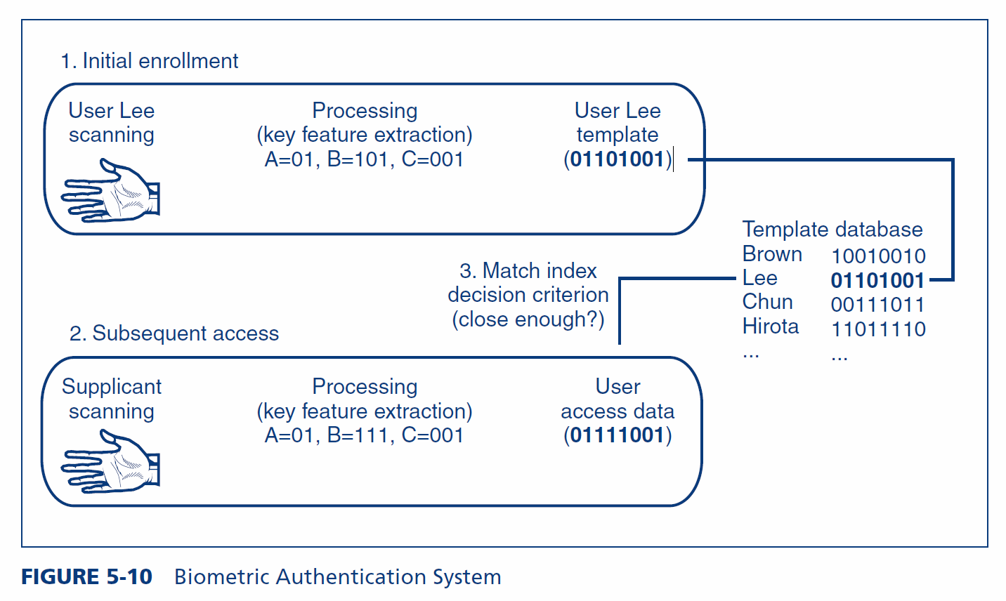
5.5: Biometric Authentication System

Slide 44
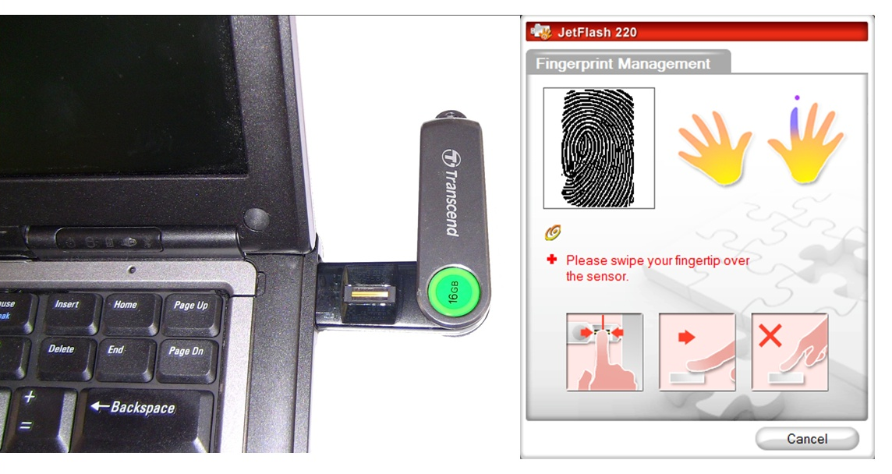
5.5: Biometric Enrollment

Slide 45
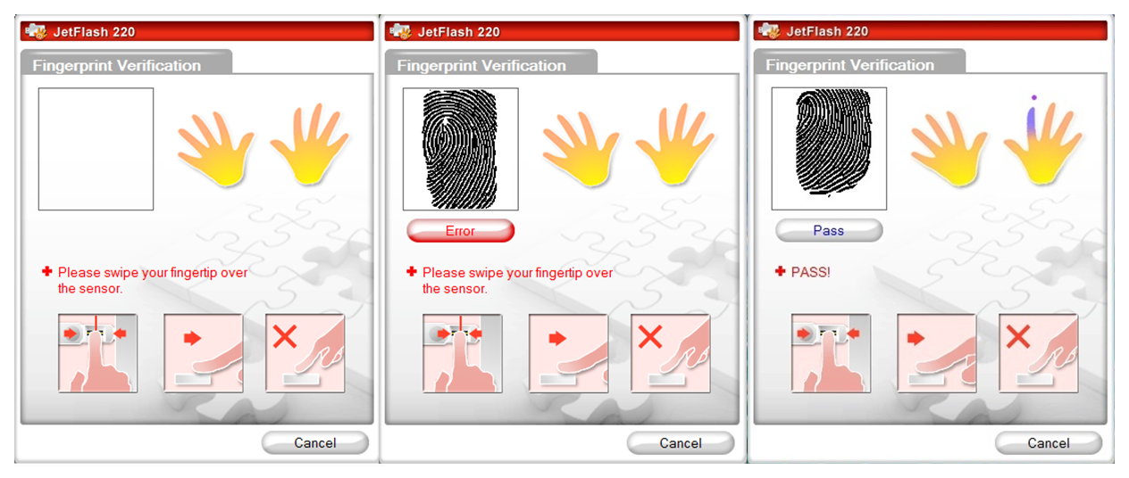
5.5: Subsequent Access

Slide 46
5.5: Biometric Errors and Deception
Errors versus Deception
False Acceptance Rates (FARs)
Percentage of people who are identified or verified as matched to a template but should not be
False Rejection Rates (FRRs)
Percentage of people who should be identified or verified as matches to a template but are not

Slide 47
5.5: Biometric Errors and Deception
Which is Worse?
It depends on the situation
Situation | False acceptance | False rejection
Identification for computer access | Security Violation | Inconvenience
Verification for computer access | Security Violation | Inconvenience
Watch list for door access | Security Violation | Inconvenience
Watch list for terrorists | Inconvenience | Security Violation

Slide 48
5.5: Biometric Errors and Deception
Vendor Claims for FARs and FRRs
Tend to be exaggerated through tests under ideal conditions
Failure to Enroll (FTE)
Subject cannot enroll in system
E.g., poor fingerprints due to construction work, clerical work, age, etc.

Slide 49
5.5: Biometric Errors and Deception
Deception
Errors: when subject is not trying to fool the system
Deception: when subject is trying to fool the system
Hide face from cameras used for face identification
Impersonate someone by using a gelatin finger on a fingerprint scanner
Etc.

Slide 50
5.5: Biometric Errors and Deception
Deception
Many biometric methods are highly vulnerable to deception
Fingerprint scanners should only be used when the threat of deception is very low
Fingerprint scanners are better than passwords because there is nothing to forget
Fingerprint scanners are good for convenience rather than security

Slide 51
5.5: Biometric Verification, Identification, and Watch Lists
Verification
Supplicant claims to be a particular person
Is the supplicant who he or she claims to be?
Compare access data to a single template (the claimed identity)
Verification is good to replace passwords in logins
If the probability of a false acceptance (false match) probability is 1/1000 per template match,
The probability of a false acceptance is 1/1000 (0.1%)

Slide 52
5.5: Biometric Verification, Identification, and Watch Lists
Identification
Supplicant does not state his or her identity
System must compare supplicant data to all templates to find the correct template
If the probability of a false acceptance (false match) probability is 1/1000 per template match,
and if there are 500 templates in the database, then
the probability of a false acceptance is 500 * 1/1000 (50%)
Good for door access

Slide 53
5.5: Biometric Verification, Identification, and Watch Lists
Watch Lists
Subset of identification
Goal is to identify members of a group
Terrorists
People who should be given access to an equipment room

Slide 54
5.5: Biometric Verification, Identification, and Watch Lists
Watch Lists
More comparisons than validation but fewer than identification, so the risk of a false acceptance is intermediate
If the probability of a false acceptance (false match) probability is 1/1000 per template match,
And if there are 10 templates in the watch list, then
the probability of a false acceptance is 10 * 1/1000 (1%)

Slide 55
5.5: Biometric Methods
Fingerprint Recognition
Simple, inexpensive, well proven
Most biometrics today are fingerprint recognition
Often can be defeated with latent fingerprints on glass copied to gelatin fingers
Fingerprint recognition can take the place of reusable passwords for low-risk applications

Slide 56
5.5: Use of HIIDETM in Correctional Facilities

Slide 57
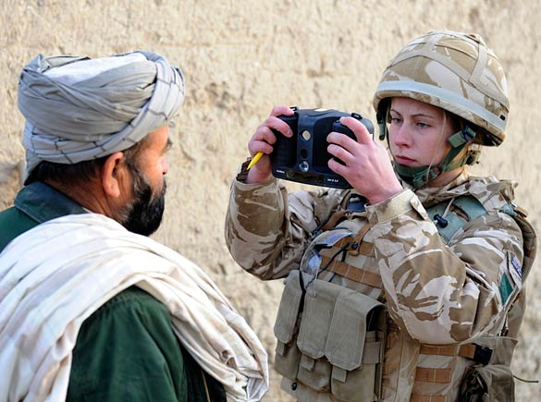
5.5: Military Use of HIIDETM

Slide 58
5.5: Biometric Methods
Iris Recognition
Pattern in colored part of eye
Uses a camera (no light is shined into eye, as in Hollywood movies)
Very low FARs
Very expensive

Slide 59
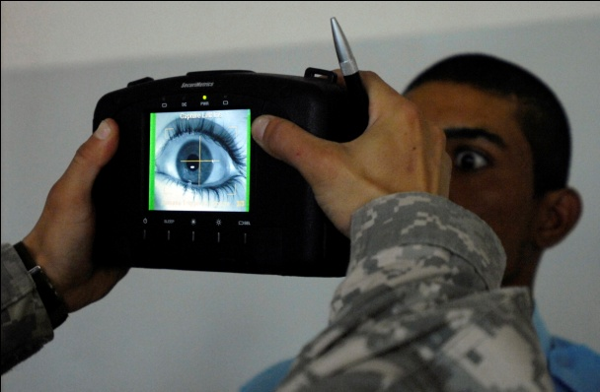
5.5: HIIDETM Eye Scan

Slide 60
5.5: Biometric Methods
Face Recognition
Surreptitious identification is possible (in airports, etc.)
Surreptitious means without the subject’s knowledge
High error rates, even without deception
Hand Geometry for Door Access
Shape of hand
Reader is very large, so usually used for door access

Slide 61
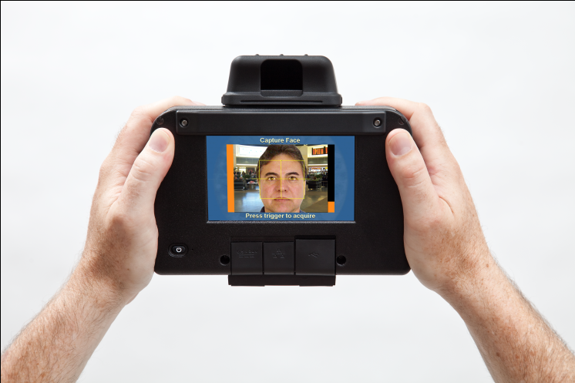
5.5: HIIDETM Face Capture

Slide 62
5.5: Biometric Methods
Voice Recognition
High error rates
Easily deceived by recordings
Other Forms of Biometric Authentication
Veins in the hand
Keystroke recognition (pace in typing password)
Signature recognition (hand-written signature)
Gait (way the person walks) recognition

Slide 63
What’s Next?
5.1 Introduction
5.2 Physical Access and Security
5.3 Passwords
5.4 Access Cards and Tokens
5.5 Biometric Authentication
5.6 Cryptographic Authentication
5.7 Authorization
5.8 Auditing
5.9 Central Authentication Servers
5.10 Directory Servers and Identity Management

Slide 64
5.6: Cryptographic Authentication
Key Points from Chapter 3
Cryptographic systems have initial and message-by-message authentication
MS-CHAP uses passwords for initial authentication
Electronic signatures provide message-by-message authentication
Key-Hashed Message Authentication Codes (HMACs) are fast and inexpensive
Digital signatures with digital certificates are extremely strong but slow
Chapter 3 did not mention that public key authentication with digital certificates are also good for initial authentication

Slide 65
5.6: Cryptographic Authentication
Public Key Infrastructures (PKIs) (Figure 5-18)
Firms can be their own certificate authorities (CAs)
Requires a great deal of labor
Provisioning
Giving the user access credentials

Slide 66
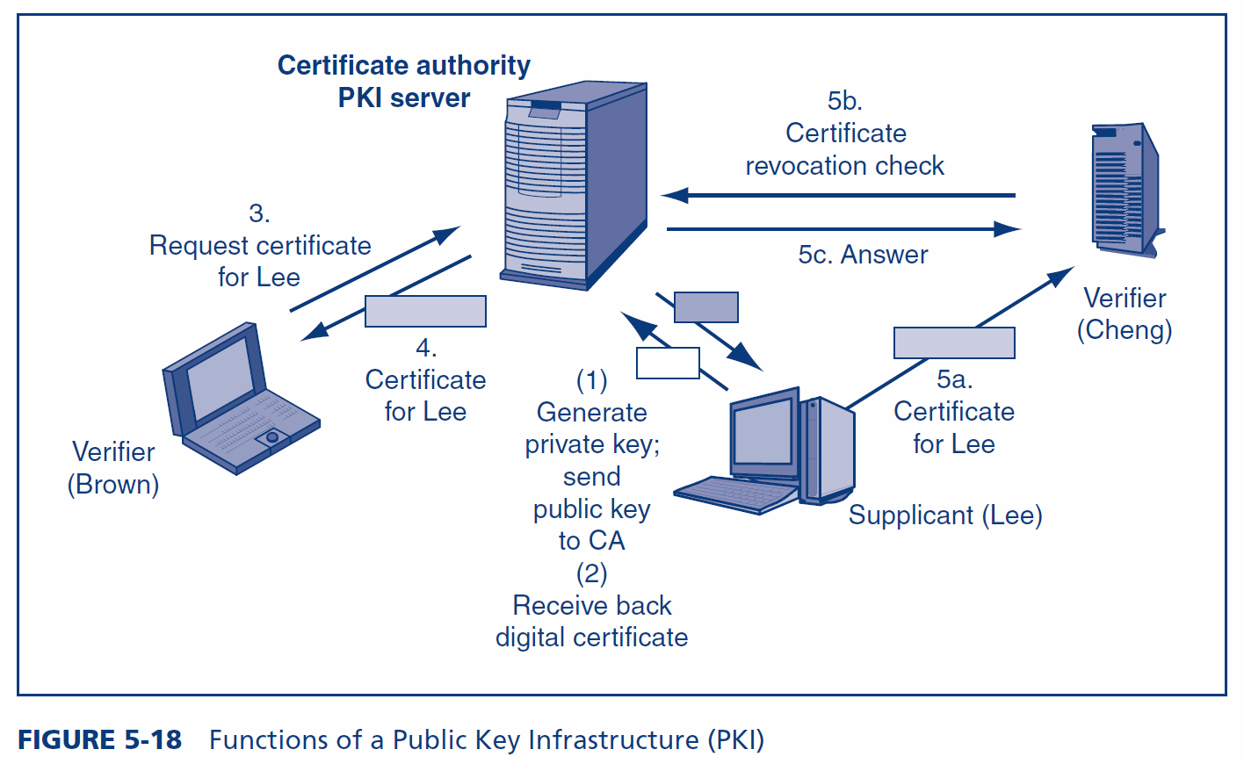
5.6: Functions of a Public Key Infrastructure (PKI)

Slide 67
5.6: Cryptographic Authentication
Public Key Infrastructures (PKIs) (Figure 5-18)
Provisioning
Human registration is often the weakest link
If an impostor is given credentials, no technology access controls will work
Limit who can submit names for registration
Limit who can authorize registration
Have rules for exceptions
Must have effective terminating procedures
Supervisors and Human Resources department must assist

Slide 68
What’s Next?
5.1 Introduction
5.2 Physical Access and Security
5.3 Passwords
5.4 Access Cards and Tokens
5.5 Biometric Authentication
5.6 Cryptographic Authentication
5.7 Authorization
5.8 Auditing
5.9 Central Authentication Servers
5.10 Directory Servers and Identity Management

Slide 69
5.7: Principle of Least Permissions
Authorizations
Authentication: Proof of identity
Authorization: The assignment of permissions (specific authorizations) to individuals or roles
Just because you are authenticated does not mean that you should be able to do everything

Slide 70
5.7: Principle of Least Permissions
Principle of Least Permissions
Initially give people only the permissions a person absolutely needs to do his or her job
If assignment is too narrow, additional permissions may be given
If assignment is too narrow, the system fails safely

Slide 71
5.7: Principle of Least Permissions
Principle of Least Permissions
System has permissions A, B, C, D, E, and F
Person needs A, C, and E
If only given A and C, can add E later although user will be inconvenienced
Errors tend not to create security problems
Fails safely
This will frustrate users somewhat

Slide 72
5.7: Principle of Least Permissions
Giving Extensive or Full Permissions Initially Is Bad
User will almost always have the permissions to do his or her job
System has permissions A, B, C, D, E, and F
Person needs A, C, and E
If given all, but take away B and D, still has F
Errors tend to create security problems

Slide 73
5.7: Principle of Least Permissions
Giving Extensive or Full Permissions Initially Is Bad
Assignments can be taken away, but this is subject to errors
Such errors could give excessive permissions to the user
This could allow the user to take actions contrary to security policy
Giving all or extensive permissions and taking some away does not fail safely

Slide 74
What’s Next?
5.1 Introduction
5.2 Physical Access and Security
5.3 Passwords
5.4 Access Cards and Tokens
5.5 Biometric Authentication
5.6 Cryptographic Authentication
5.7 Authorization
5.8 Auditing
5.9 Central Authentication Servers
5.10 Directory Servers and Identity Management

Slide 75
5.8: Auditing
Auditing
Authentication: Who a person is
Authorization: What a person may do with a resource
Auditing: What the person actually did

Slide 76
5.8: Auditing
Logging
Events
On a server, logins, failed login attempts, file deletions, and so forth
Events are stored in a log file

Slide 77
5.8: Auditing
Log Reading
Regular log reading is crucial or the log becomes a useless write-only memory
Periodic external audits of log file entries and reading practices
Automatic alerts for strong threats

Slide 78
What’s Next?
5.1 Introduction
5.2 Physical Access and Security
5.3 Passwords
5.4 Access Cards and Tokens
5.5 Biometric Authentication
5.6 Cryptographic Authentication
5.7 Authorization
5.8 Auditing
5.9 Central Authentication Servers
5.10 Directory Servers and Identity Management

Slide 79
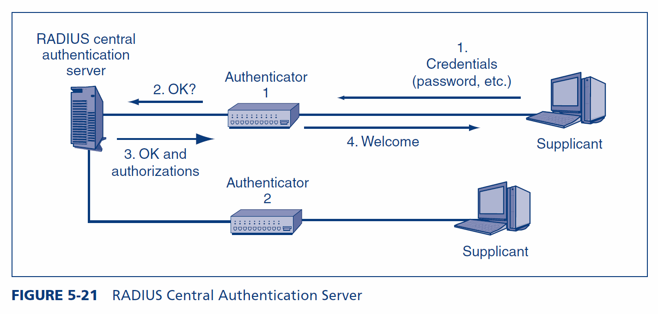
5.9: RADIUS Central Authentication Server

Slide 80
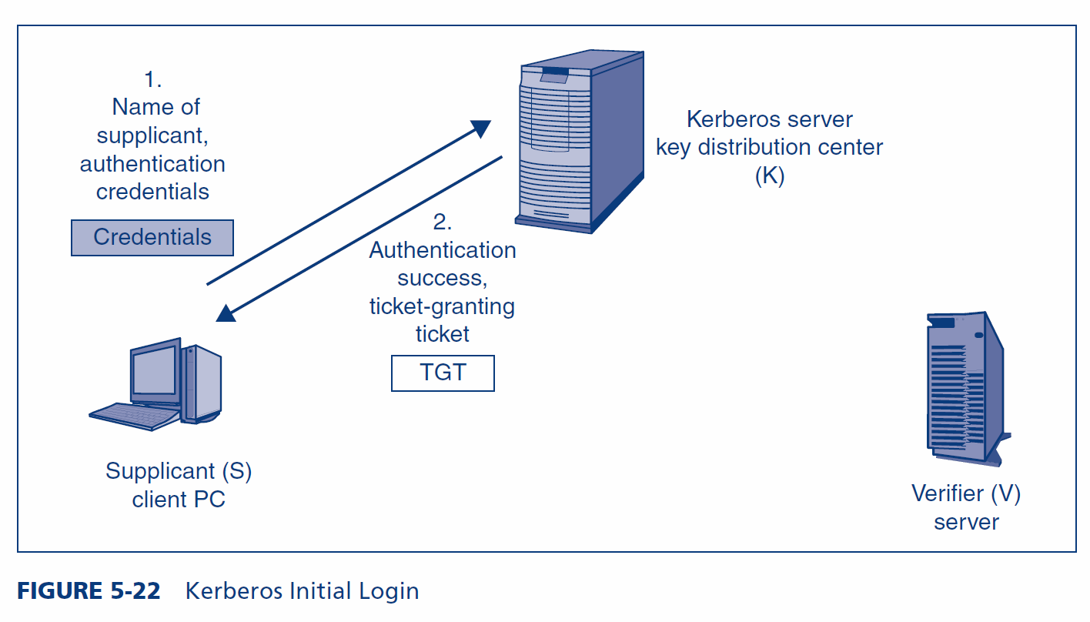
5.9: Kerberos Initial Login

Slide 81
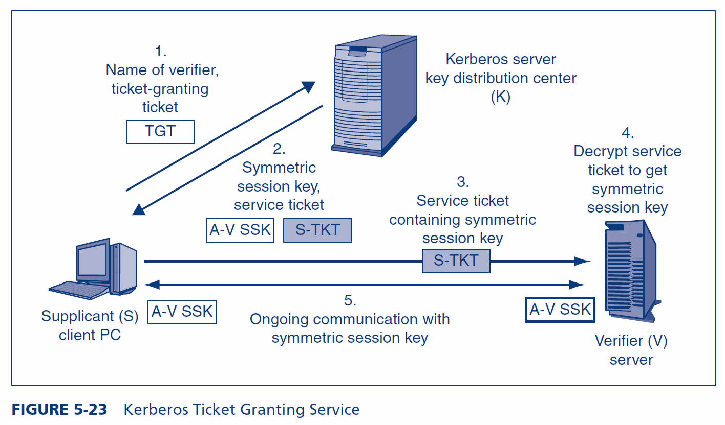
5.9: Kerberos Ticket Granting Service

Slide 82
What’s Next?
5.1 Introduction
5.2 Physical Access and Security
5.3 Passwords
5.4 Access Cards and Tokens
5.5 Biometric Authentication
5.6 Cryptographic Authentication
5.7 Authorization
5.8 Auditing
5.9 Central Authentication Servers
5.10 Directory Servers and Identity Management

Slide 83
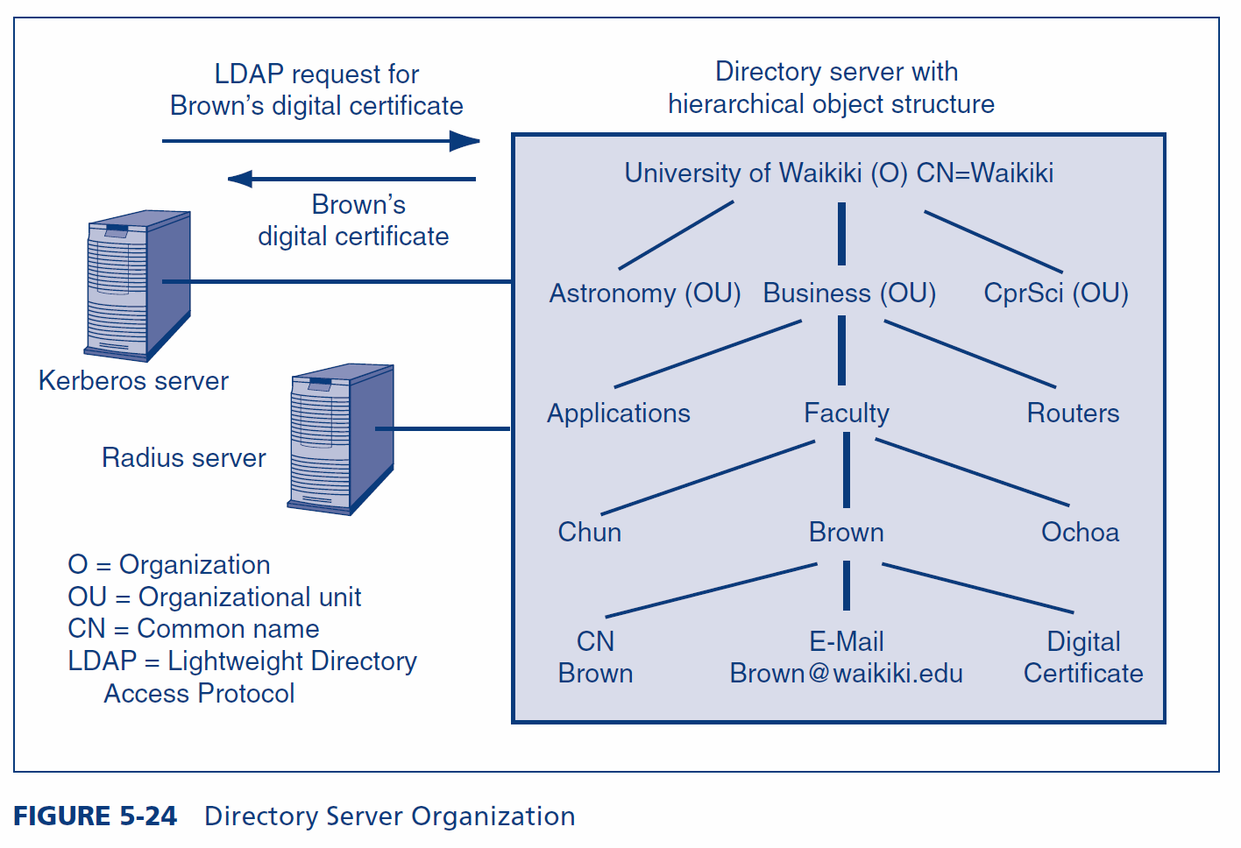
5.10: Directory Server Organization

Slide 84
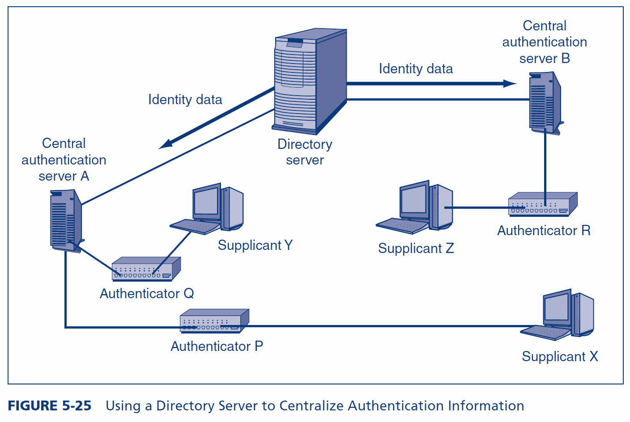
5.10: Using a Directory Server to Centralize Authentication Information

Slide 85
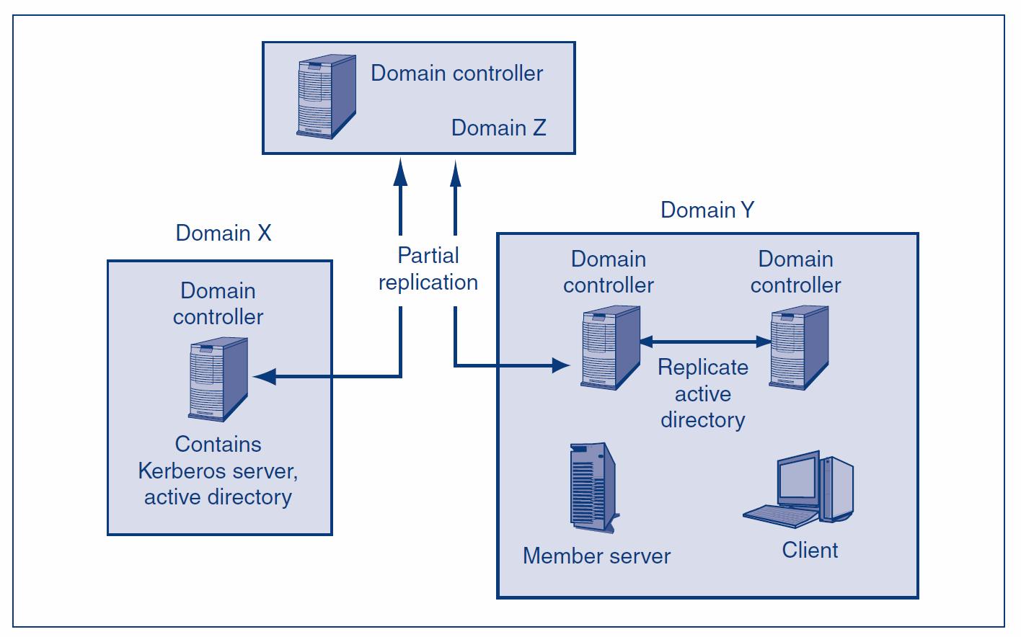
5.10: Active Directory Domains and Tree
Domains are controlled
by domain controllers
The corporation is
divided into
Microsoft domains
Each domain controller
runs Kerberos and AD
A domain can have
multiple domain controllers

Slide 86
5.10: Active Directory Domains and Tree
There can be a
tree of domains
Not shown:
There can be a forest of trees
Domain controllers in
parent and child domains
do partial replication
Domain controllers in a
domain do total replication

Slide 87
5.10: Trust Directionality and Transitivity
Trust
One directory server will accept information from another
Trust Directionality
Mutual
A trusts B and B trusts A
One-Way
A trusts B or B trusts A, but not both

Slide 88
5.10: Trust Directionality and Transitivity
Trust Transitivity
Transitive Trust
If A trusts B
and B trusts C,
then A trusts C automatically
Intransitive Trust
If A trusts B
and B trusts C,
this does NOT mean that A trusts C automatically

Slide 89
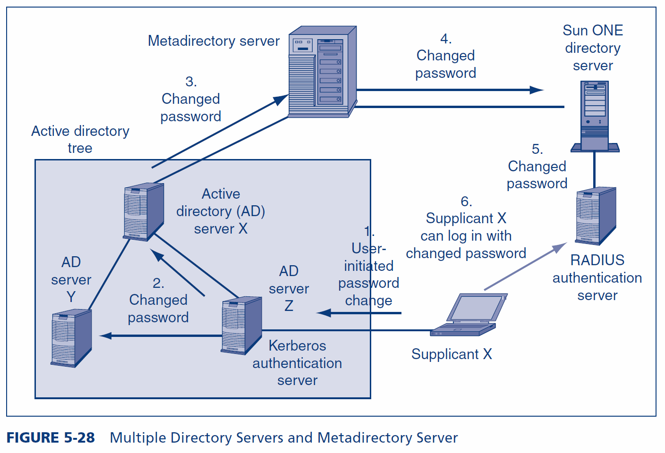
5.10: Multiple Directory Servers and Metadirectory Server
A Metadirectory server
synchronizes multiple
directory servers

Slide 90
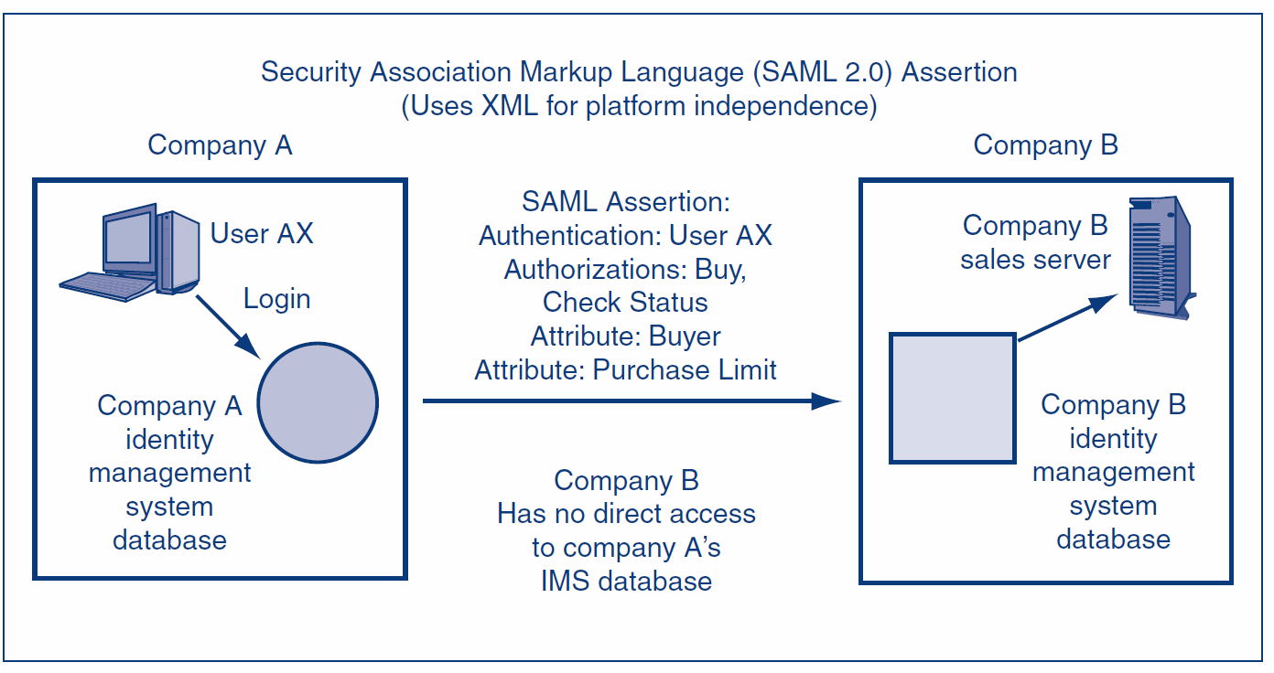
5.10: Federated Identity Management
In federated identity management,
business partners do not access each other’s databases.
Instead, they send assertions about a person.
The receiver trusts the assertions.

Slide 91
5.10: Federated Identity Management
Types of Assertions:
Authentication, Authorizations, Attributes
Assertions are standardized by SAML.
SAML uses XML for platform independence.

Slide 92
5.10: Identity Management
Definition
Identity management is the centralized policy-based management of all information required for access to corporate systems by a person, machine, program, or other resource.

Slide 93
5.10: Identity Management
Benefits of Identity Management
Reduction in the redundant work needed to manage identity information
Consistency in information
Rapid changes
Central auditing
Single sign-on
Increasingly required to meet compliance requirements
At least reduced sign-on when SSO is impossible

Slide 94
5.10: Identity Management
Identity
The set of attributes about a person or nonhuman resource that must be revealed in a particular context
Subordinate to a particular person
Manager of a department
Buyer dealing with another company
Manager responsible for a database
Principle of minimum identity data: only reveal the information necessary in a particular context

Slide 95
5.10: Identity Management
Identity Management
Initial credential checking
Defining identities (pieces of information to be divulged)
Managing trust relationships
Provisioning, reprovisioning if changes, and deprovisioning

Slide 96
5.10: Identity Management
Identity Management
Implementing controlled decentralization
Do as much administration as possible locally
Requires tight policy controls to avoid problems
Providing self-service functions for non-sensitive information
Marital status, etc.

Slide 97
The End

Slide 98
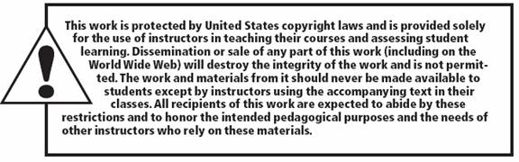
All rights reserved. No part of this publication may be reproduced, stored in a retrieval system, or transmitted, in any form or by any means, electronic, mechanical, photocopying, recording, or otherwise, without the prior written permission of the publisher. Printed in the United States of America.
Copyright © 2015 Pearson Education, Inc.

